Slide 1


Slide 2
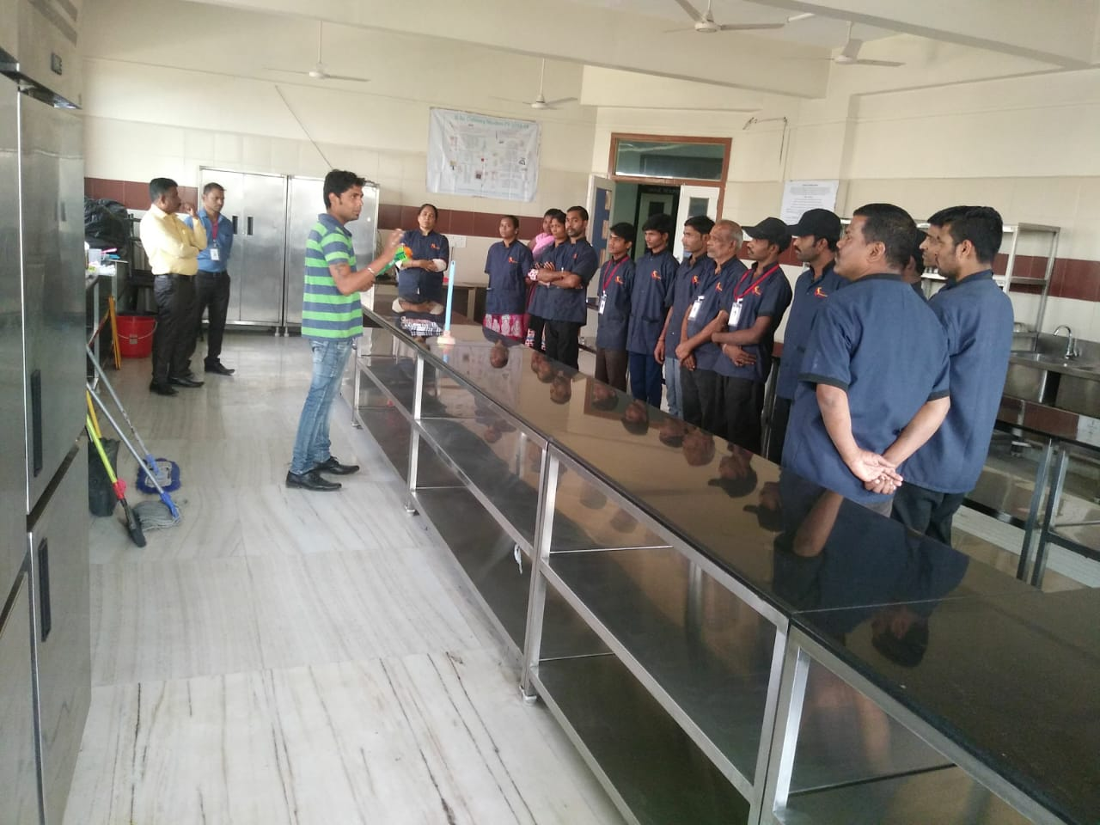
ABOUT US
20+ years of industry experience in hospitality and facility management.
Specialized in housekeeping, manpower outsourcing, and facility maintenance.
Empowering workers with training, recognition, and meaningful employment.

Slide 3
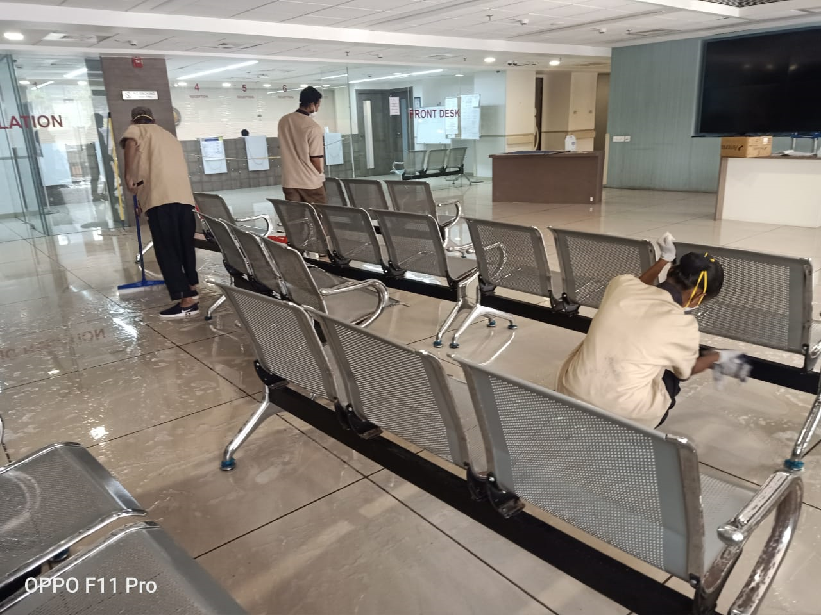
Our Cleaning Philosophy
We believe “a clean working and living environment is a healthy working and living environment”.

Slide 4
WHY GO FOR VS FACILITY MANAGEMENT SERVICE?
We provide range of services :
Housekeeping Services
Front Desk/Data Entry Operators
Hospital Support Staff (Ward Attendants - Male/Female)
Swimming Pool Maintenance Staff
Electricians and Plumbers
Gardeners, Pantry Boys, Stewards, Room Attendants
Housekeeping Cleaning Materials
Services for Malls, Clubs, Hotels, Resorts, Schools, Hospitals

Slide 5
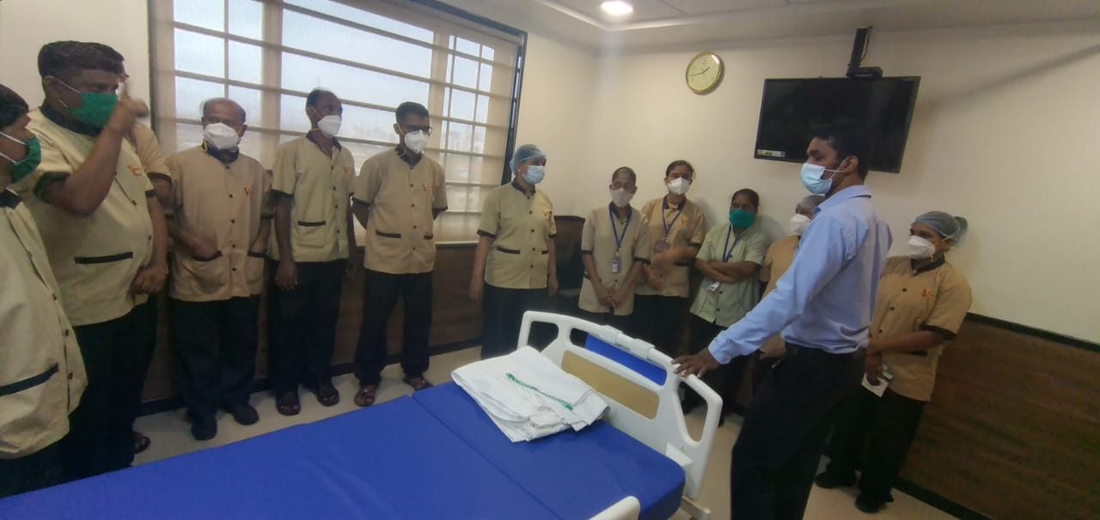
STRENGTHS
Experienced, energetic, and multi-skilled team
Regular job and skill enhancement training
Periodic audits and equipment maintenance history
Positive and professional working environment

Slide 6
OUR VISION & MISSION.
We at V.S. Facility Management Services thrive to deliver cost effective and customer centric House Keeping and Facility management solutions to help our Business partners and society at large in building an eco-friendly and cleaner environment.
We aim to become a leading facility management services provider in Mumbai and provide quality services. We are committed to regular training of our employees to enable them to deliver total customer satisfaction.

Slide 7
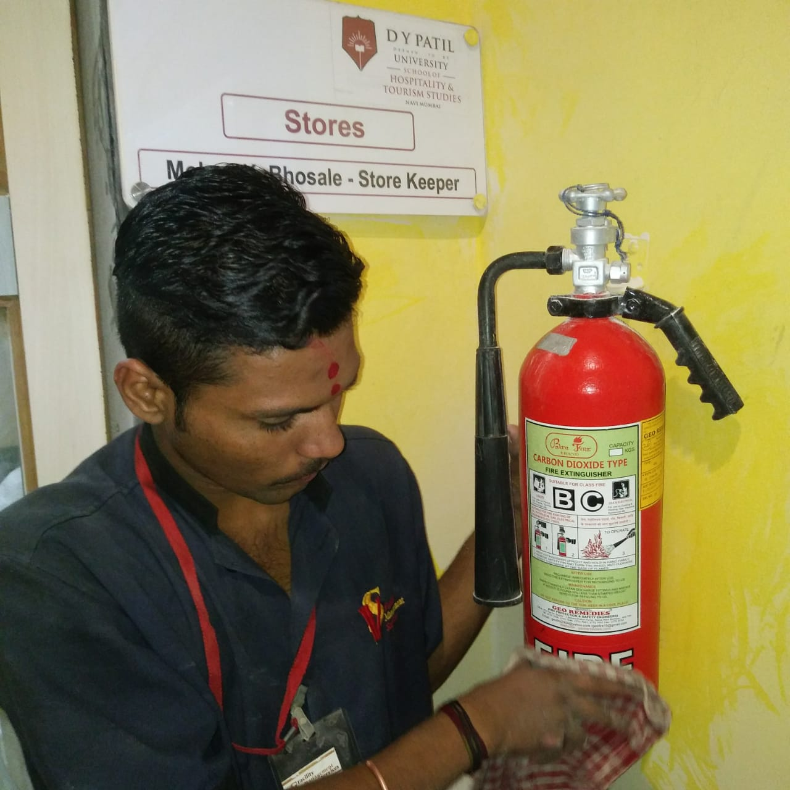
VARIOUS TYPE OF CLEANING ACTIVITY AND TRAINING CONDUCTED BY TRAINERS

Slide 8
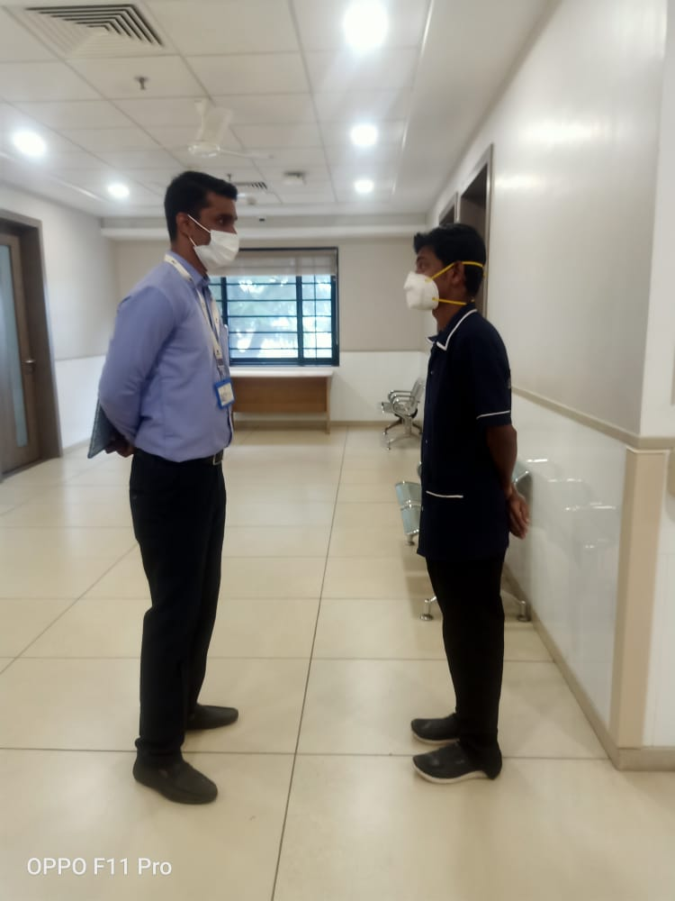
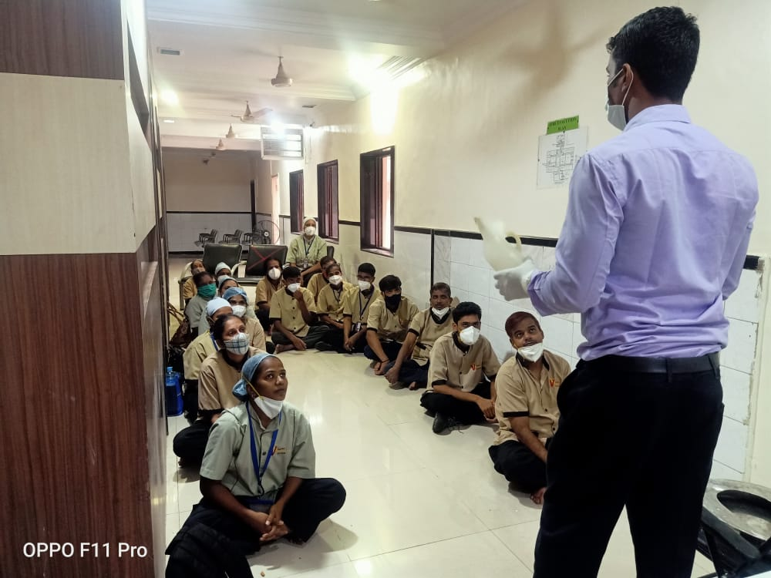
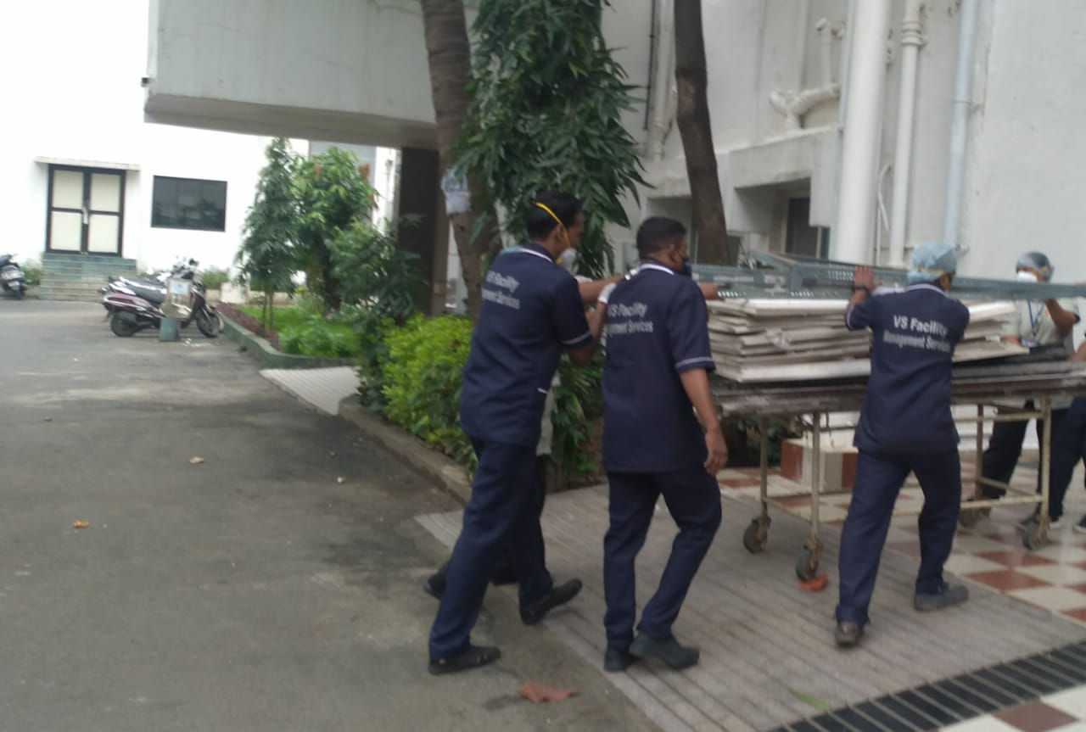
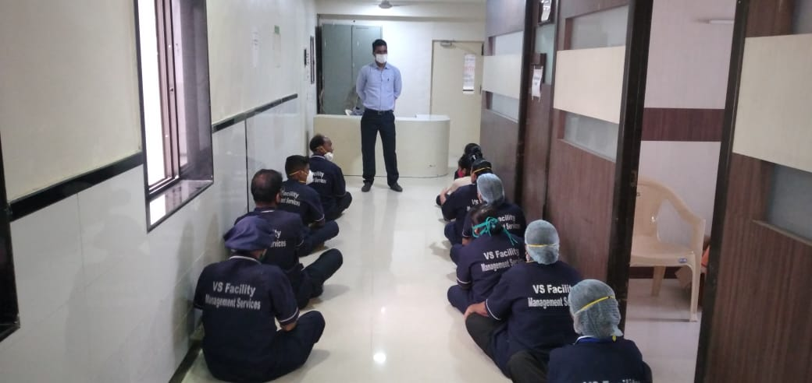
PERSONALISED TRAINING /SHIFTING WORK /GROUP TRINING

Slide 9
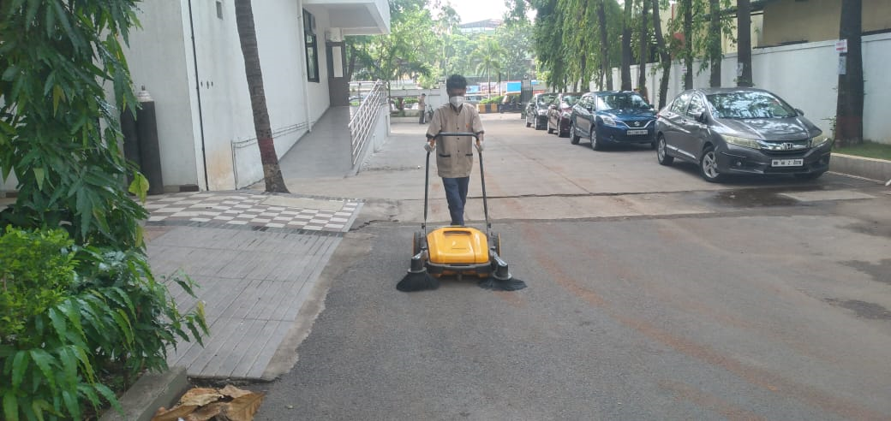
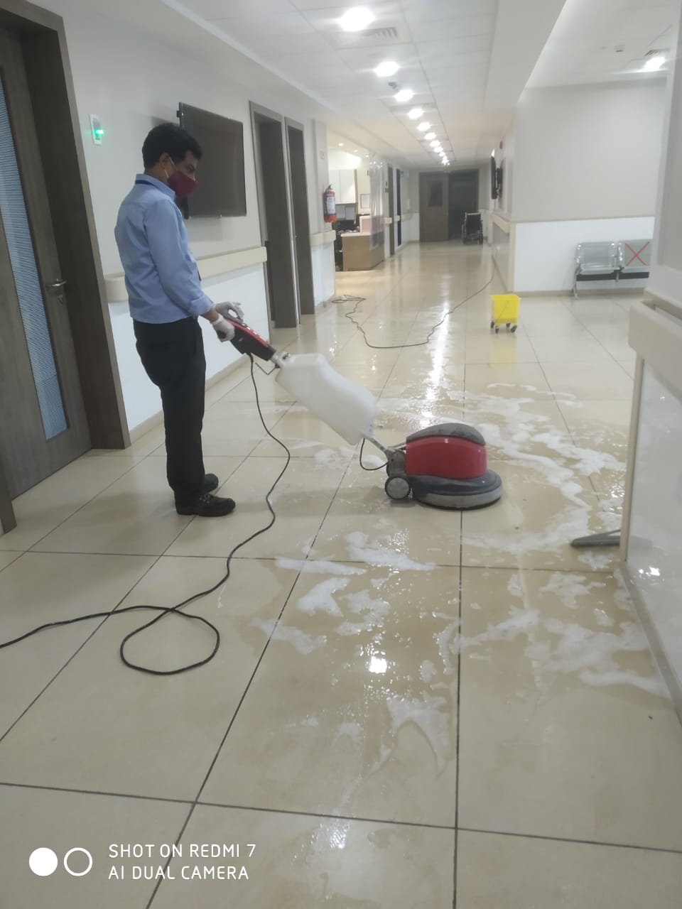
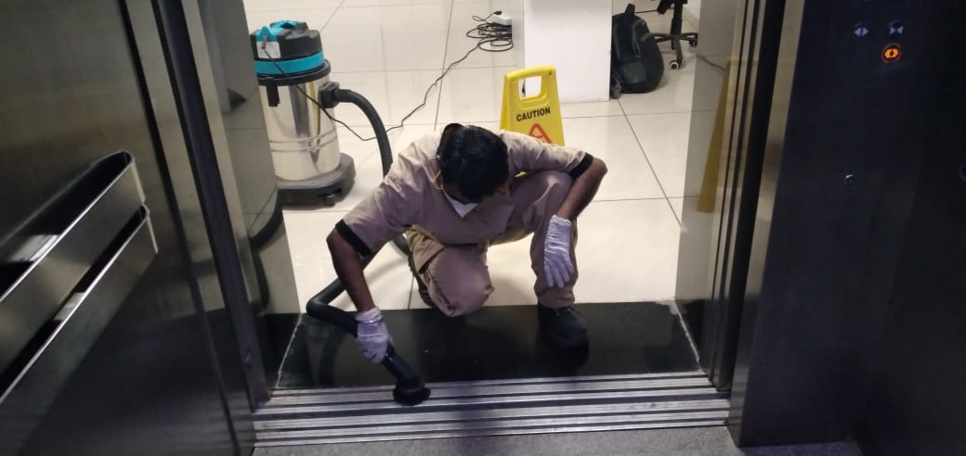
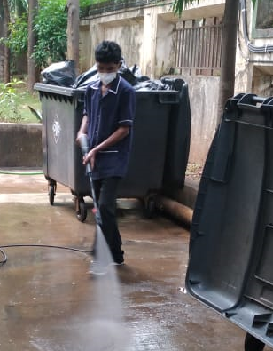
VARIOUS TYPE OF EQUIPPED CLEANING

Slide 10
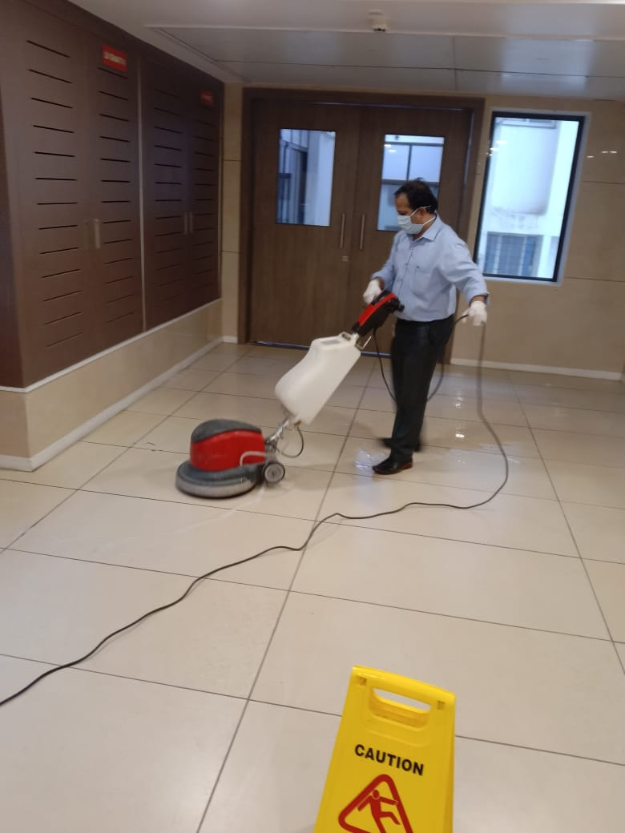
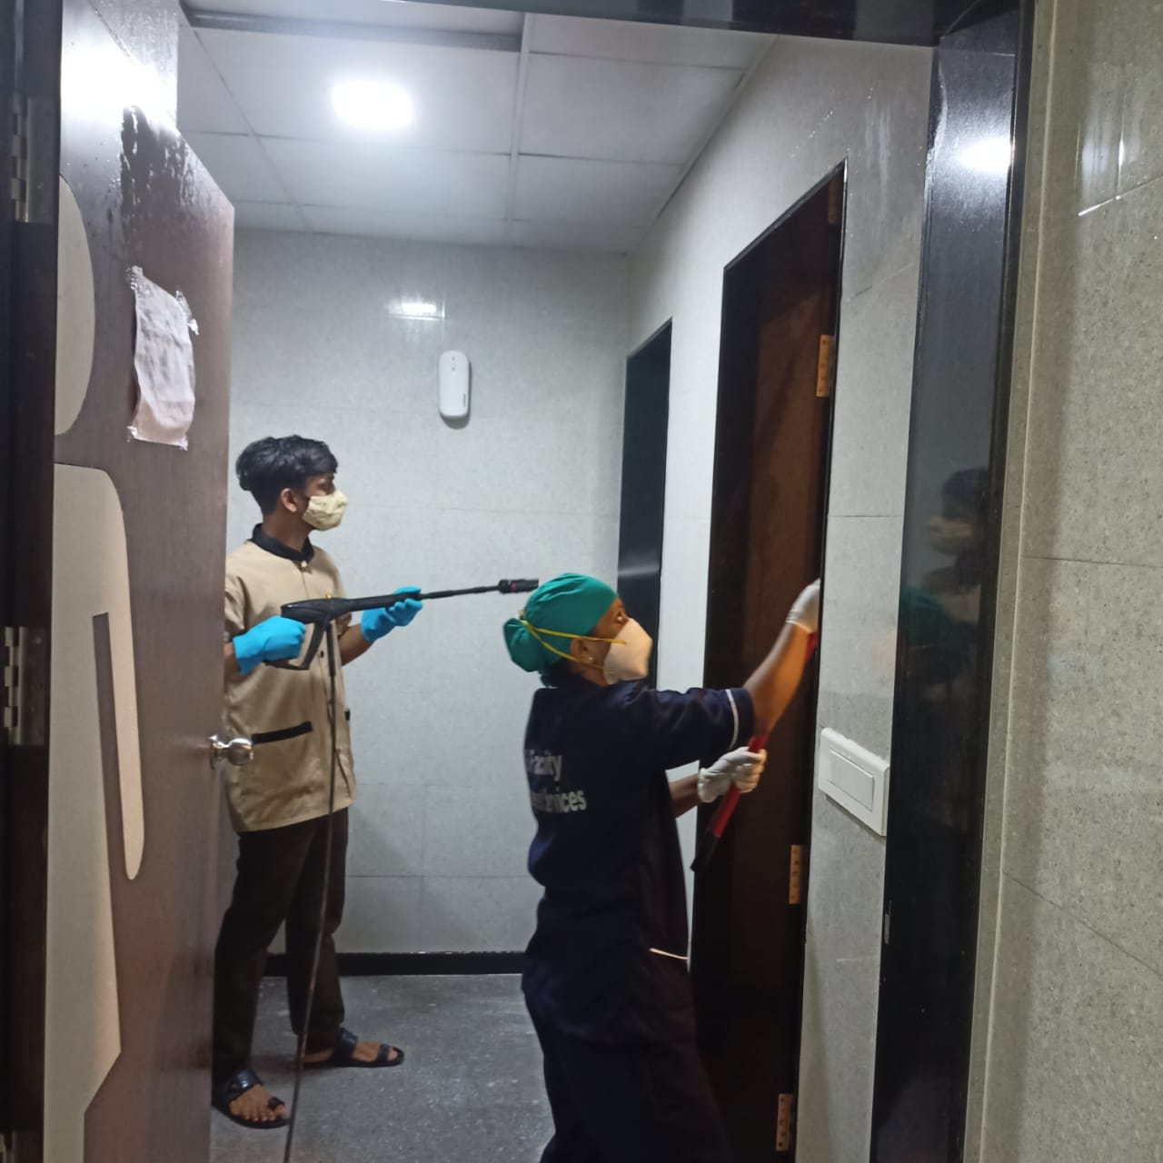
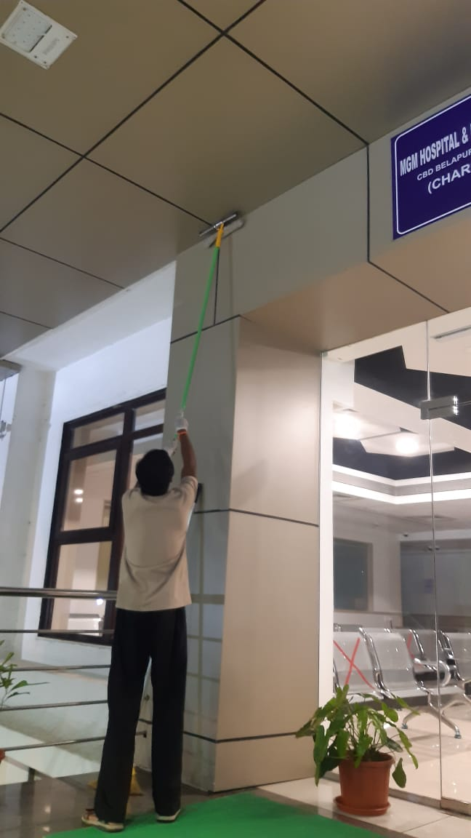
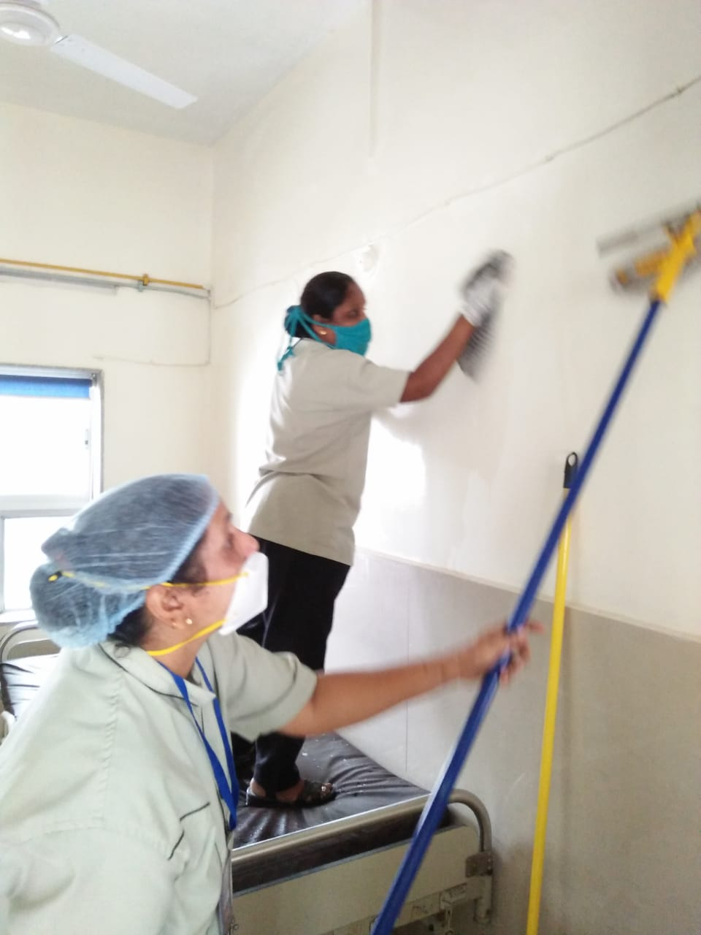
WEEKLY DEEP CLEANING ACTIVITY

Slide 11
OUR LEGAL COMPLIANCES
Provident Fund Registration number :THVSH1725018000
ESIC: 31001131570001019
GSTIN Number : 27AEVPJ0307C2ZQ
Profession Tax Number : 27291589958P
Udyog Aadhar Number : MH18D0028301

Slide 12
OUR CLIENTS
01. MGM Hospital & Research Centre (C.B.D Belapur) Navi Mumbai.
02. MGM Hospital & Research Centre (Sanpada) Navi Mumbai.
03. MGM Nursing collage (Nerul Navi Mumbai)
04. Emerald Club (Chembur Mumbai)
05. Club Emerald (Royal Palm Goregaon)
06. Perfect Decor for Lawns.
07. Acres Club for banquets Events.
08. Desai Resort (Chiplun)
09. Viraj Steels (Bhoisar)
10. Dr. J. J Magdum College of Engineering (Jaysingpur)
11. KPT Industries Ltd. (Kolhapur)
12. Inspirea (Data Entry Bombay Hospital)

Slide 13
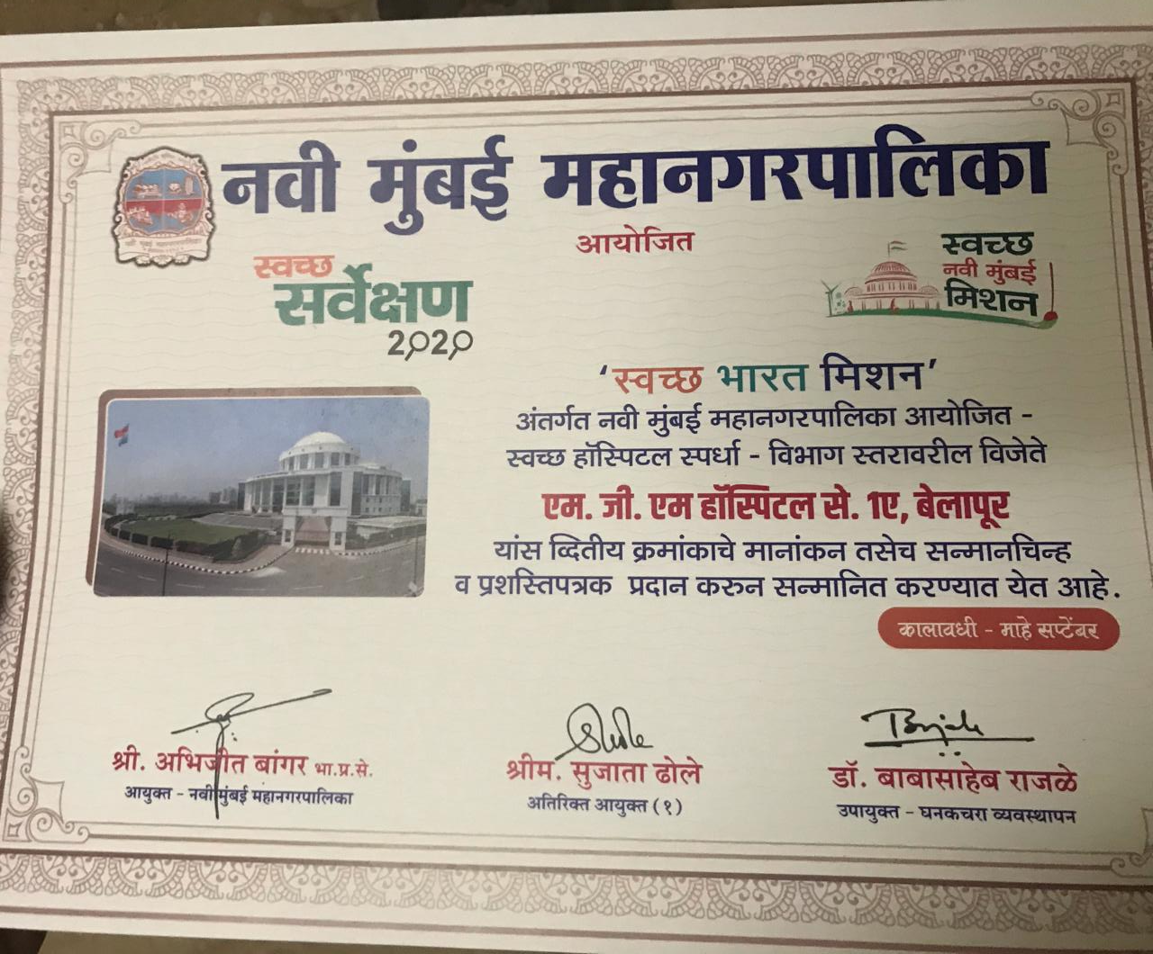
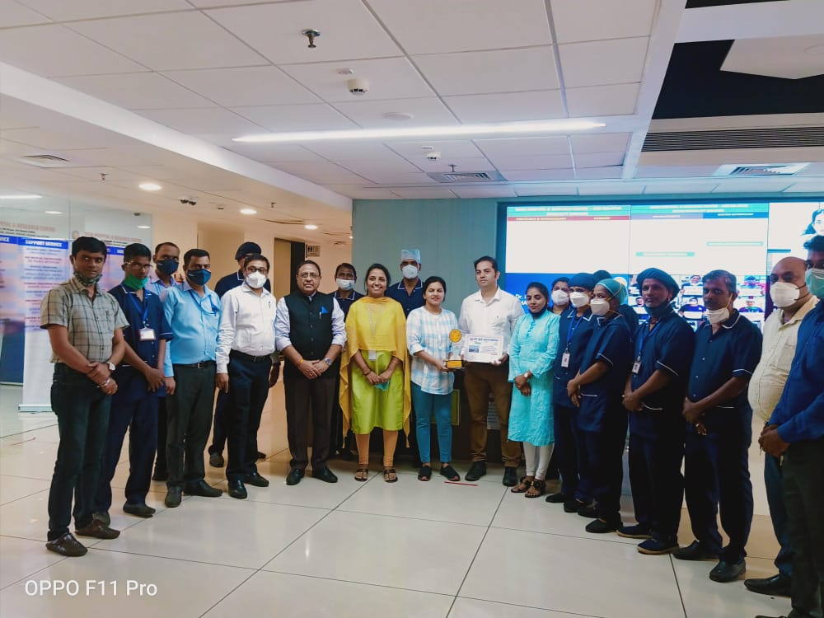
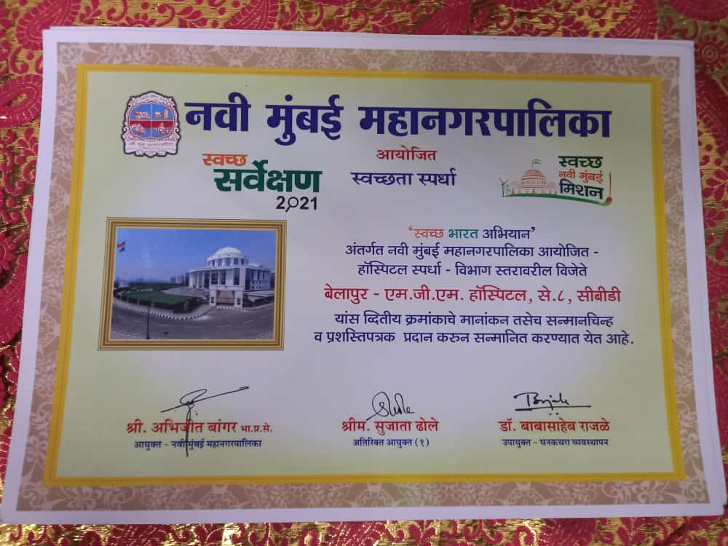
Our Achievements

Slide 14
FINANCE & ADMIN HEAD (VS FACILITY MANAGEMENT SERVICES)
& PRESIDENT FOR SAMBODHI FOUNDATION
MRS. VARSHA JADHAV
HAVING 17 YEARS OF EXPERIENCE IN FINANCE AND ADMINISTRATION .
WORKING PASSIONATELY FOR SAMBODHI FOUNDATION BY:
PROVIDING EDUICATION TO STUDENTS IN NEED.
CREATING AWARENESS IN SPORTS.
PROVIDING JOBS FOR THE YOUTHS AS PER THEIR EDUICATION AND SKILS.
PROVIDING JOBS AND AN OPPORTUNITY TO SETUP THEIR OWN BUSINESS TO OUR YOUNG GENERATION .
EMPOVERING WOMEN IN NEED BY GIVING SMALL JOB OPERTUNITY AND BUSINESS OPERTUNITIES.
WORKING FOR ENVIRONMENT AND SUSTAINABLE GROWTH IN MUMBAI & SOON FOR OUR STATE & OUR COUNTRY.
FOUNDER OF VS FACILITY MANAGEMENT SERVICES
MR. AMIT JADHAV
VS FACILITY MANAGEMENT STARTED IN 2014, Mr. AMIT JADHAV , HAVING 20 YEARS OF EXPERIENCE IN HOSPITALITY INDUSTRIES .
WE WORKED IN SOME OF THE PRIME PROPERTIES,
GIVING HIS BEST SERVICES, WE PROMTED GRADUALY FROM EXECUTIVE TO ASSTSTANT GENERAL MANAGER.
HE STARTED HIS JOURNY IN THIS BUSINESS WITH 2 STAFF AND NOW WE HAVE 200 STAFF.
SOME PART OF THE INCOME JANURTED IS USED FOR THE SOACIAL CAUSES, AS WE ALSO RUN THE NGO NAMED SAMBODHI FOUNDATION. WHO WORKS FOR EDUCATION & GETTING JOBS FOR YOUTHS & WOMENS AND MANY MORE ACTIVITIES.

Slide 15

Contact Us: Phone: 9819693499 / 8097711221 Email: vs.fmsgroups@gmail.com Thank you for your time and interest!

